Slide 1
”Know thyself” Self-tracking, data, and technocized selves
Elise Li Zheng
Ph.D. Candidate, School of History and Sociology, Georgia Tech

Slide 2

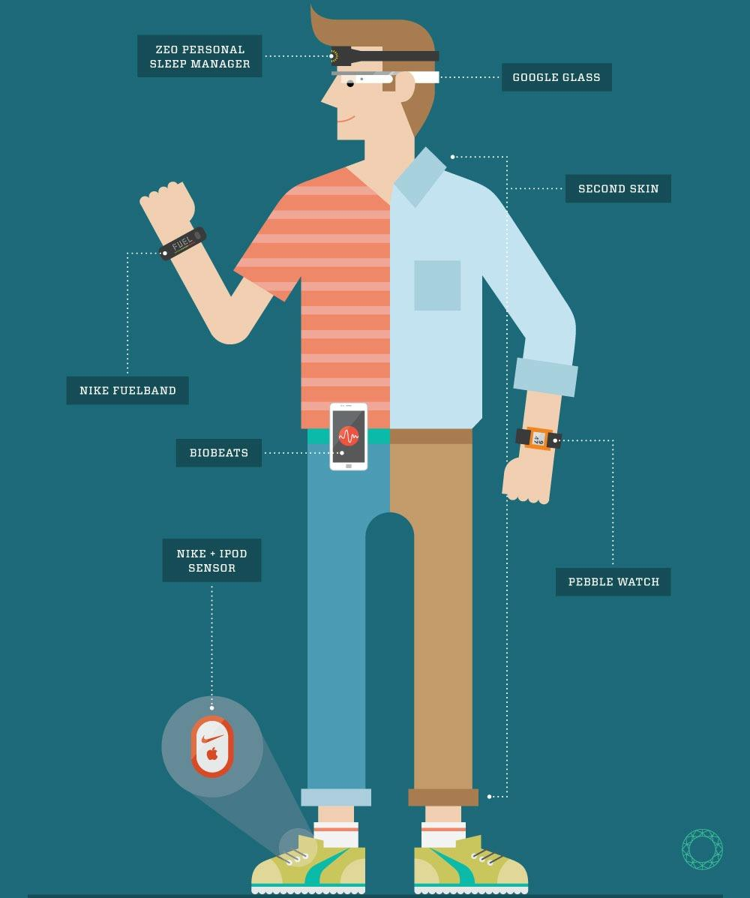

Slide 3
What is Self-tracking?
Self-tracking and health outcomes
What can self-tracking tell us?
How would self-tracking shape us?

Slide 4
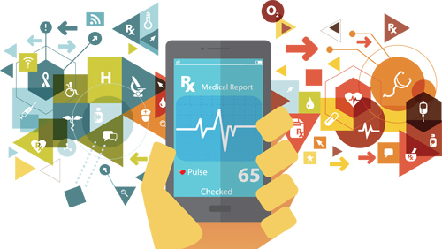
I. What is Self-tracking?
Journals, spreadsheets, logs
Wearables, fitness gadgets, smartphone sensors
From active to passive
“Quantified Self” movement and design trends

Slide 5
I. What is Self-tracking?
Quantified Self Movement:
“data-driven” way of seeing self;
towards comprehension and optimization
A core element in design, and digital health services
gamification;
passive/smooth;
self-initiated data collection.

Slide 6
II. Does Self-tracking Work?
Mixed results: behaviors, perceptions
Novelty, short-term benefits

Slide 7
III. What does data say about ourselves?
Data is a “paradigm” (Cheney-Lippold, 2011)
power of algorithmic categorization, to label and regulate or even control digital presence
Data is an “abstraction” (Ajana, 2017&2018; Schull, 2016)
Inward-looking, self-centered way of abstracting life and health
Data is a “proxy” (Lupton 2017; Ruckenstein, 2016)
“data-doubles” “digital doppelgänger”: representation of us; but collected, organized, and calculated in a way that is radically different from our living experience.

Slide 8
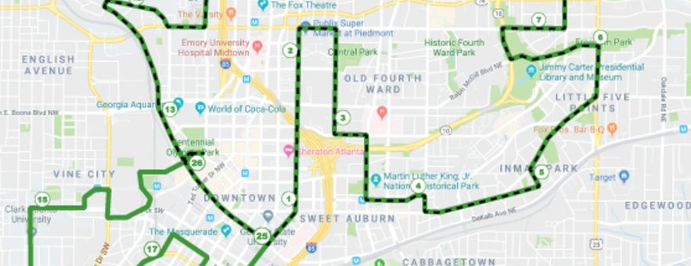
e.g., Self-tracking of running & multiple data constructions

Slide 9
IV. Can data shape ourselves?
Data’s social value: in the context of social exchange
“Thing-power”: certain norms and meanings are hardwired and automated into material affordances;
Different modes of self-tracking and data use in different social settings: private, communal, control & exploitation.
human and nonhuman agencies
hybrid assemblages and cyborgs

Slide 10

IV. Can data shape ourselves?
Self-tracking data and health
Self-responsibility as health-ethics
“Big data” and normalization
individualized/personalized health – the merge of corporate value and selfhood

Slide 11
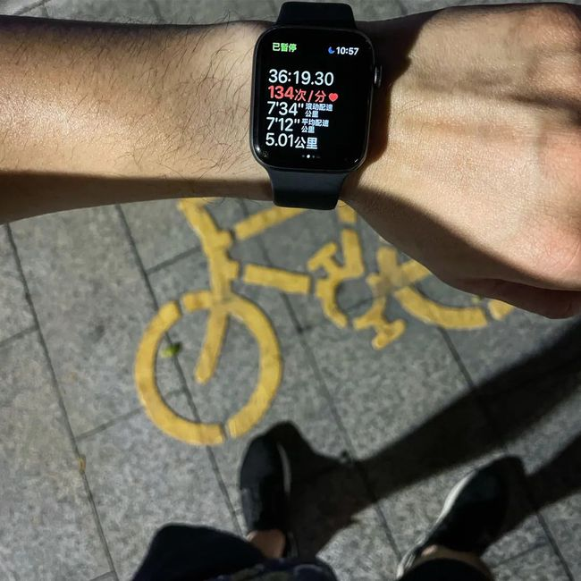

My Research: richer context and finer nuances, non-western
Overworking culture (“996”) and stressed-out workforce
Self-help in “sub-health”
How was data given meanings through technological practices? What are those data, and how interpretation works?
E.g., monitoring of Concept making and defining: “Productivity” & “Stress”

Slide 12
Thanks! Q&A
elise901@gatech.edu

